Slide 1


Development of Song-Lyric Automatic Alignment System (Final Presentation & Demo)
SNU MARG & NAVER
2014.02.19

Slide 2
Project Overview
Step 1
Vocal Enhancement
Obejctive: Automatically align lyric with the corresponding music.
Step 1: Perform vocal enhancement in order to segregate vocals from the polyphonic sound mixtures.
Step 2: Perform singing voice activity detection to remove non-vocal sections.
Step 3: Create a language phone model to extract Korean vowels from the audio.
Step 4: Align Korean vowel sequence with text lyric data.
Step 2
Singing Voice Activity
Detection
Step 3
Korean Vowel
Detection
Step 4
Lyric Alignment

Slide 3
Step 1. Vocal Enhancement

Slide 4
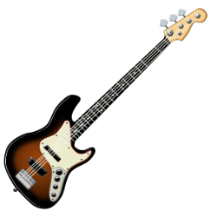
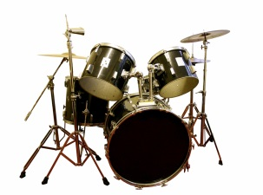
Objective
Remove or suppress the instrument sound and enhance the vocal part from the original audio signal.
Use unique acoustic features of the vocal.
Estimate the predominant f0 prior to extracting the vocal signal.
Vocal
Enhancement

Slide 5
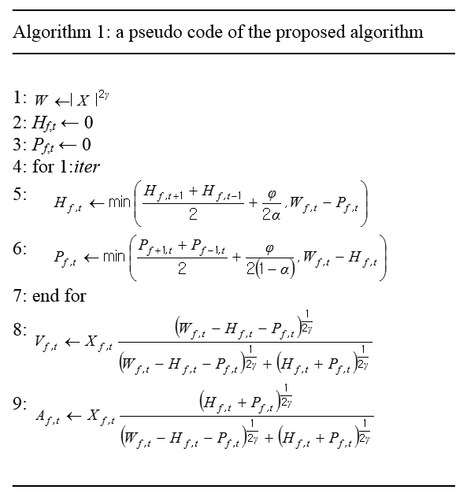
Algorithm Overview
STFT
Vocal separation
Soft masking
High pass filter
Inverse STFT

Slide 6
Modeling
A spectrogram of the music (W) can be represented as a sum of the spectrograms of harmonic (H), percussive (P), and vocal (V).
γ : a parameter for the scale compression - to compensate the gap between the ideal and the practical model

Slide 7
Modeling (cont.)
Characteristic of each musical component - Harmonic sound : harmonic structure, relatively stationary > shown as horizontal ridges in the spectrogram - Percussive sound : broadband spectra, short sustain time > vertical ridges - Vocal : harmonic structure, non-stationary spectra > cannot be classified neither harmonic nor percussive sound > sparse distribution

Slide 8
Modeling (cont.)
Cost function - minimize the spectral/temporal gradients of the harmonic/percussive spectrogram. - the residual component, which is forced to have a sparse distribution is considered as vocal
α : a relative weight between the smoothness of H and P
φ : a relative weight for the vocal L1-norm minimization

Slide 9
Optimization
Equivalent vocal term using non-negativity and summation constraints The cost function can be represented using H and P only, without V.
Differentiations of the cost function : the optimal H and P can be obtained iteratively.

Slide 10
Optimization (cont.)
The optimal H and P are iteratively obtained as step 5 and 6
Minimum filter : to satisfy V > 0
vocal signal in the non-compressed spectrogram domain is obtained using soft mask
110Hz HPF is used as a post-processing step

Slide 11
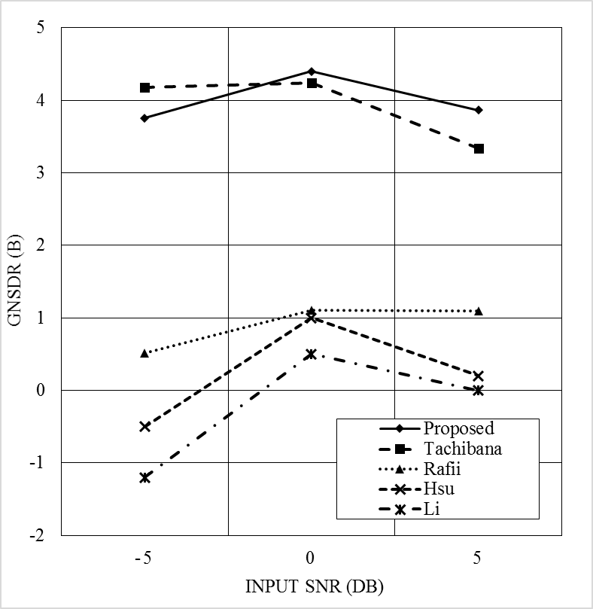
Statistical Results
Database : MIR-1K
The highest GNSDR results in 0dB and 5dB
-5dB : vocal signal is quite weaker than accompaniment > rarely occur in real-world music

Slide 12
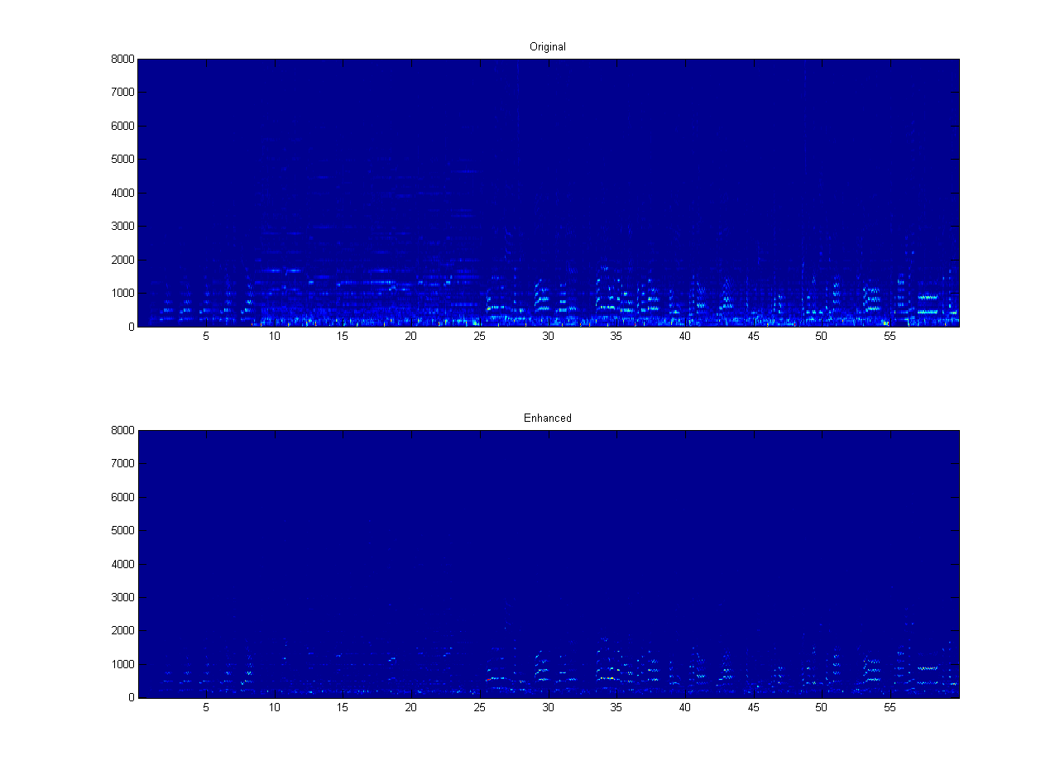

Sound Samples
버스커버스커 - 벚꽃엔딩

Slide 13
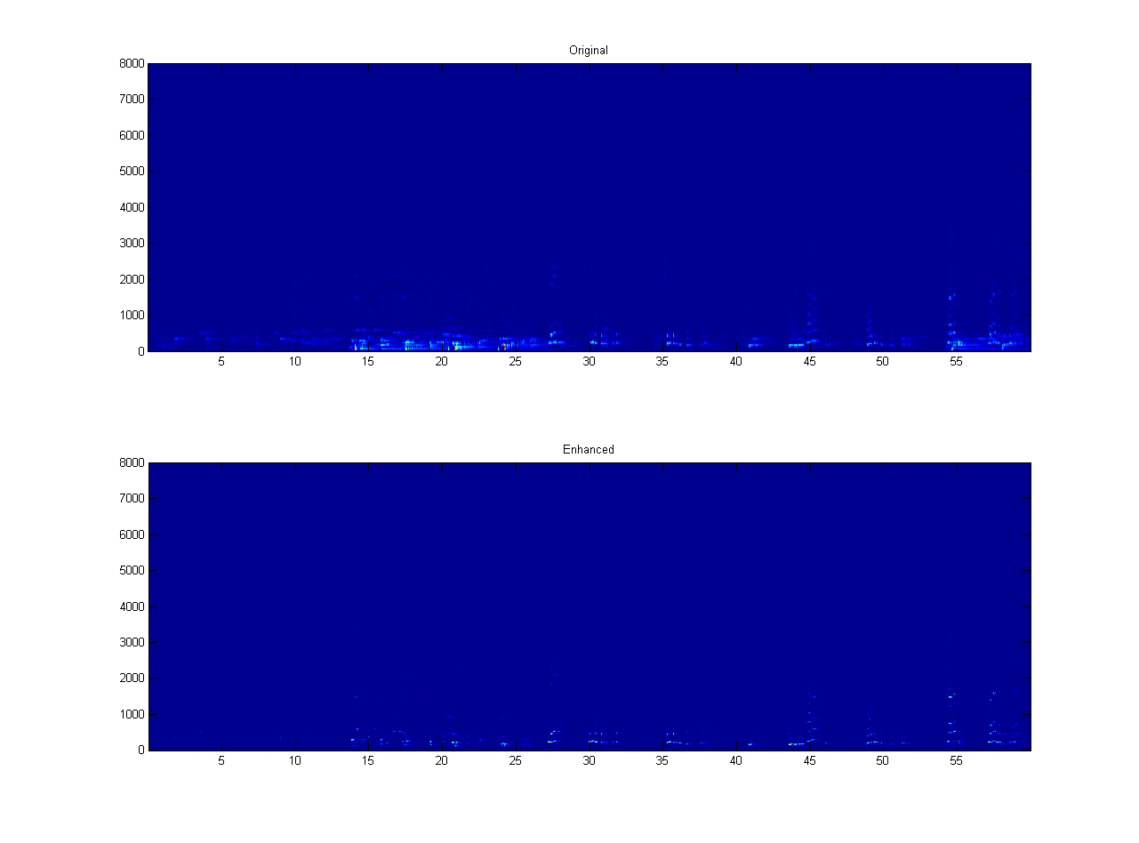
Sound Samples
김범수 - 끝사랑

Slide 14
Step 2. Singing Voice Activity Detection

Slide 15
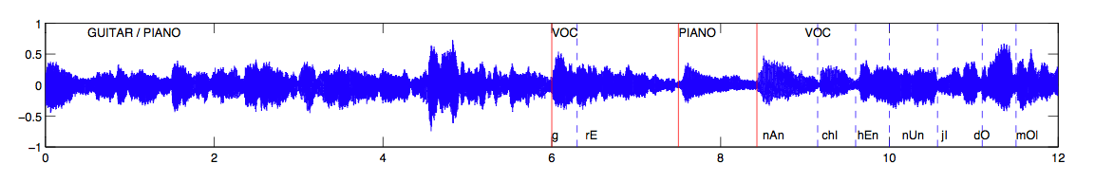
Objective
Automatic frame-level segmentation of pop song into Vocal (voice+ accompaniment) and Non-Vocal section from audio.
Input : vocal enhanced signal which contains pre-dominant melody by {Instrument, Voice, Instrument+Voice}.
Non-Vocal
Vocal

Slide 16
Characteristics of Singing Voice
Formants: identifying vowel sounds.
Harmonicity: naturally harmonic due to resonance of vocal tract.
Natural Vibrato :
- average 6Hz (Prame, 1998).
- 0.6 ~ 2 semitones for singers.
- 0.2 ~ 0.35 semitones for string players (Timmers, 2000).

Slide 17
Horizontal Edge Elimination
Idea: Use of characteristics of human voice within the spectrogram.
Instruments
Voice

Slide 18
Algorithm Overview
Spectrogram
Column-wise normalization
Gaussian blurring
Peak
masking
Horizontal edge detection
+
-
Estimated voice peak
Element-wise
multiplication
Estimated voice spectrogram
Median filtering
Estimated voice activation

Slide 19
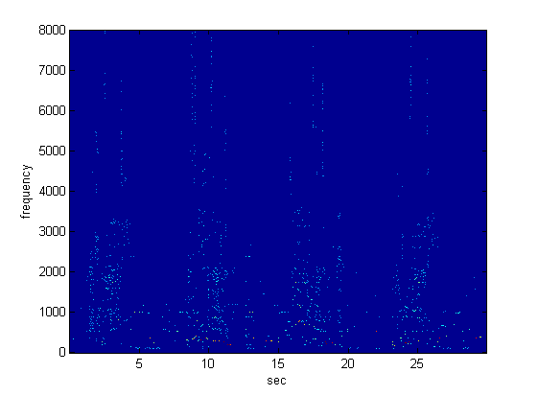
Experiment Result
웃으며 넘길래 – Jrabbit Original: SVAD:

Slide 20
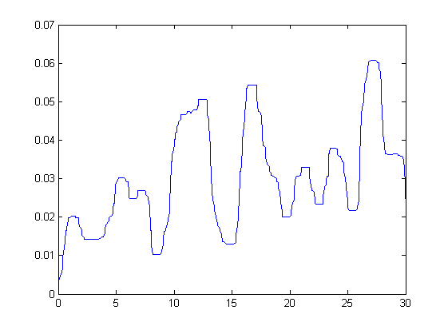
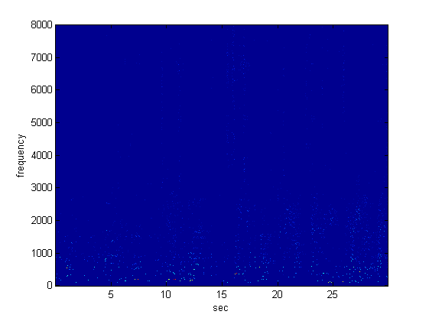
Experiment Result
취중진담 – 김동률 Original: SVAD:

Slide 21
Step 3. Korean Vowel Detection

Slide 22
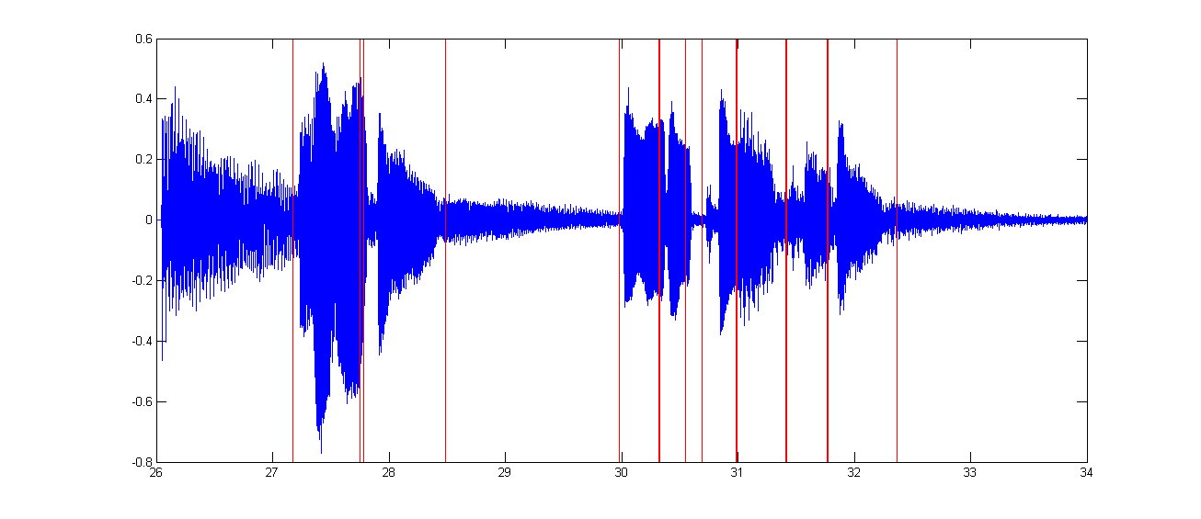
Objective
sil ae ah sil e eo ae ah eu ae sil
Detect 7 Korean vowels (ah, eo, o, u, eu, e, ae) + silence from each frame of the song.
Two different approaches
1) Use hand-crafted features (MFCC)
2) Use machine learned features (RBM)

Slide 23
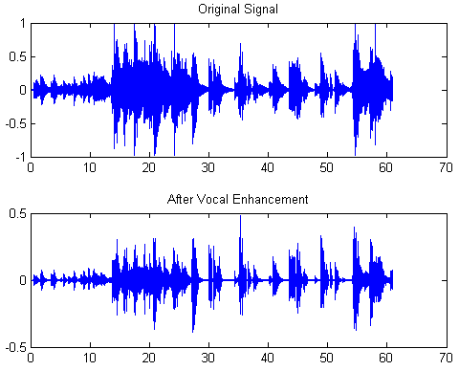
Song Data Description
vowel start end
ae 27.146 27.726
ah 27.853 28.342
e 29.938 30.319
eo 30.355 30.518
ae 30.790 30.990
ah 30.953 31.262
eu 31.534 31.751
ae 31.806 32.205
eu 35.215 35.559
ae 35.686 36.049
eo 36.067 36.303
eo 36.575 36.956
ah 37.481 37.608
o 37.717 38.025
eo 40.782 41.017
…
25 ballad Korean songs and 3 other genre Korean songs were manually labeled for training and evaluation.
Contains approximately even numbers of female and male singers.
Evaluation data contains 6 ballad songs and 3 other genre songs. (Rap/Dance/Metal)

Slide 24
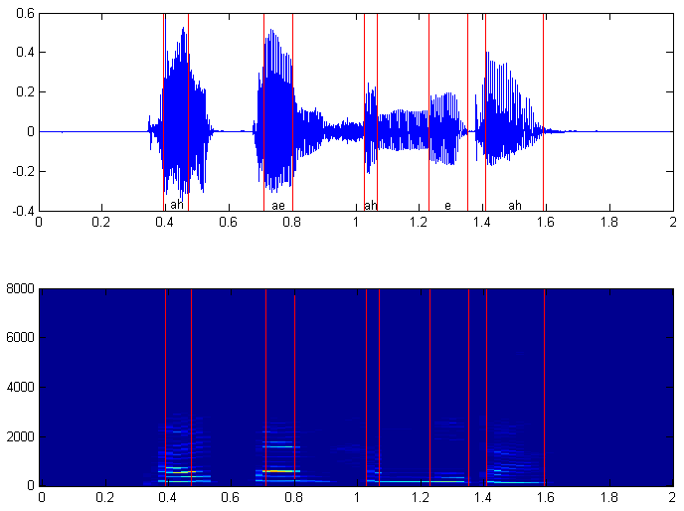
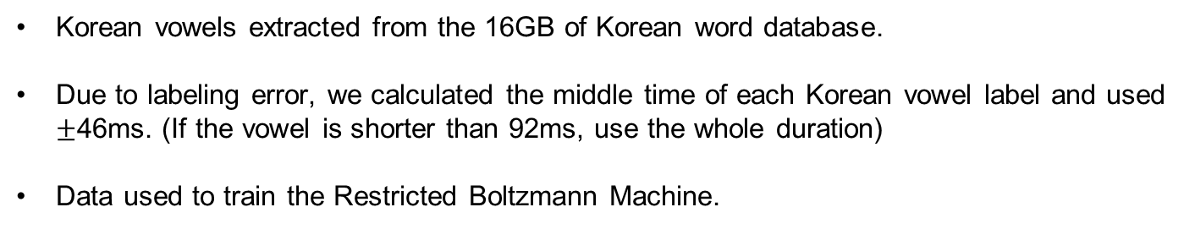
Voice Data Description
vowel start end
b 0.344 0.391
ah 0.392 0.473
B 0.670 0.709
ae 0.710 0.801
m 0.802 0.898
h 1.019 1.026
ah 1.027 1.068
m 1.069 1.153
m 1.154 1.228
i 1.229 1.352
d 1.373 1.408
ah 1.409 1.592
Korean vowels extracted from the 16GB of Korean word database.
Due to labeling error, we calculated the middle time of each Korean vowel label and used $±$46ms. (If the vowel is shorter than 92ms, use the whole duration)
Data used to train the Restricted Boltzmann Machine.

Slide 25
Algorithm Overview
Korean vowel audio
Low-level feature
MFCC (13d)
Mel-frequency Spectrum
High-level feature
visible
Restricted Boltzmann Machine (RBM)
hidden
High-level feature
Classifier
(Random Forest)
Classifier (Support Vector Machine)
Hand-crafted features: MFCC (13 dimension) of Korean vowel audio extracted from Korean Song dataset.
Machine learned features: Learn high-level features using the Restricted Boltzmann Machine (RBM).
Classifiers : Random Forest (RF) & Support Vector Machine (SVM).

Slide 26
Random Forest Classification
Random forests are an ensemble learning method for classification (and regression) that operate by constructing a multitude of decision trees at training time and outputting the class that is the mode of the classes output by individual trees.
For example, root of the tree in the figure above means each data has equal probability. (25%)
Next, tree is divided into two branches by the threshold that makes the best information gain.
Iterate steps above.
13 dimensional MFCC extracted from ‘song dataset’, and used for Random Forest training.

Slide 27
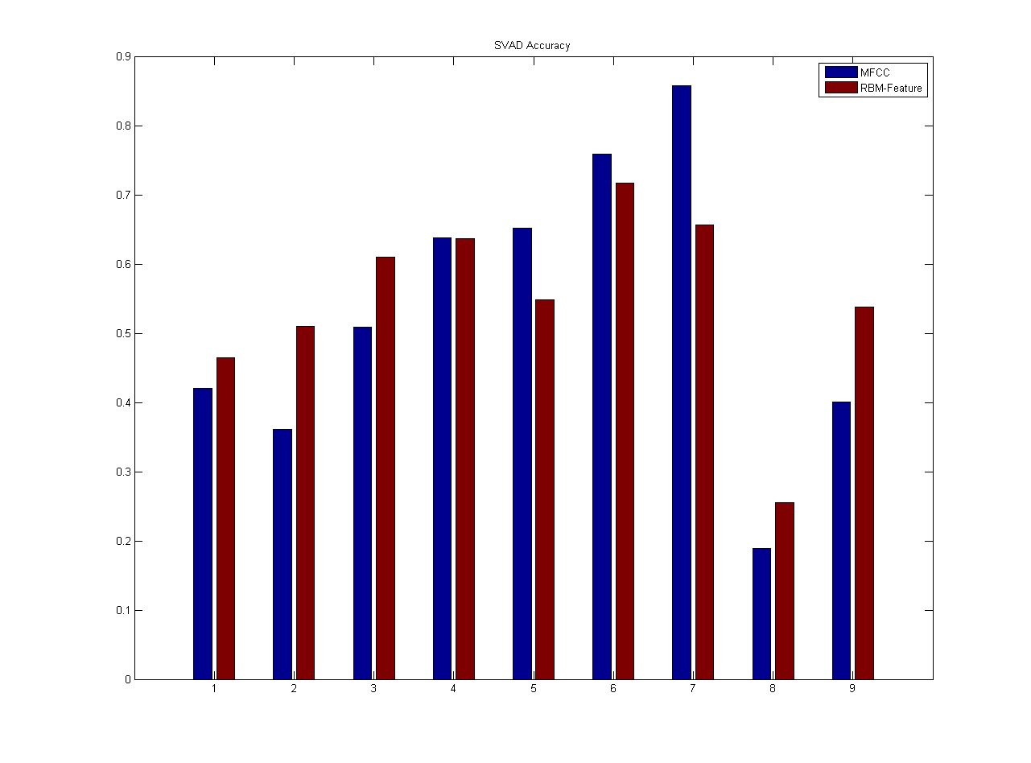
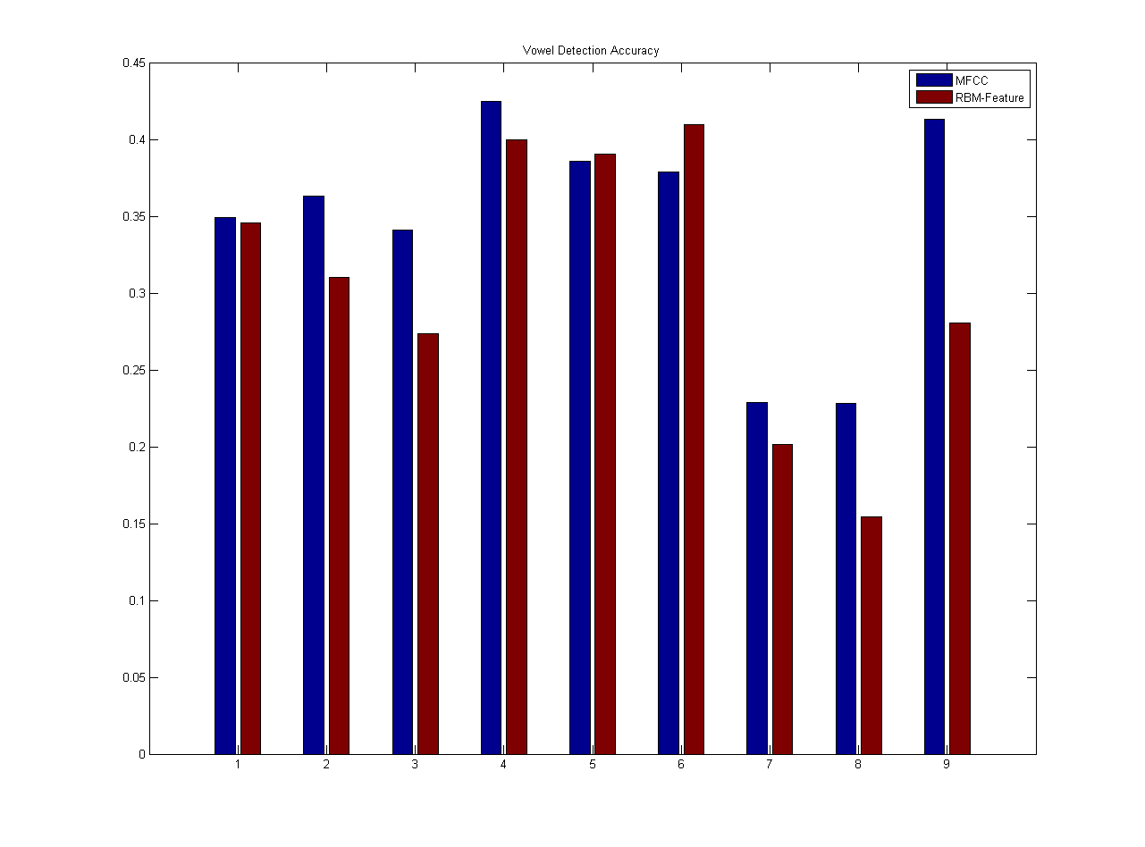
Classification Results
Label Description:
1. Male/Dance/Unseen (G-Dragon) 6. Male/Ballad/Voice Seen (김범수)
2. Male/Ballad/Unseen (버스커버스커) 7. Female/Ballad/Voice Seen (백지영)
3. Male/Rap/Unseen (슈프림팀) 8. Male/Metal/Unseen (시나위)
4. Male/Ballad/Voice Seen (허각) 9. Female/Ballad/Voice Seen (윤하)
5. Female/Ballad/Voice Seen (티아라)

Slide 28
Step 4. Audio-Lyrics Alignment

Slide 29
Audio-Lyrics Alignment Overview
Objective: to align Lyric sequence to Vowel-class Probability output.
Input : Class Probability and Symbol Sequence.
Observation: we can generate (number of observation frame) X (number of symbol transition) matrix from the input.
Viterbi Alignment: assuming Left-to-Right HMM.
Duration Model: optimize Gamma Distribution parameter by Maximum-Likelihood Estimation (MLE) manner.
Vowel Classifier
Output
Lyric Symbols
Observation Probability Matrix
Viterbi Alignment
with
Duration Model

Slide 30
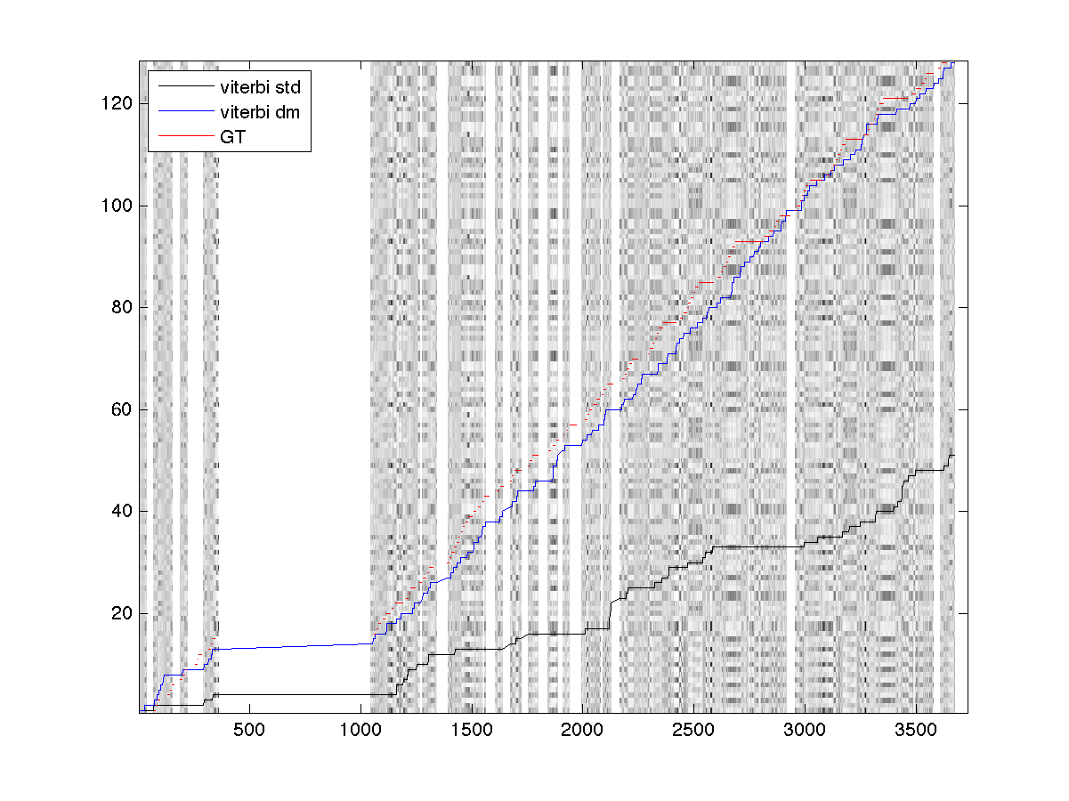
Audio-Lyrics Alignment Examples
버스커버스커 – 벚꽃 엔딩

Slide 31
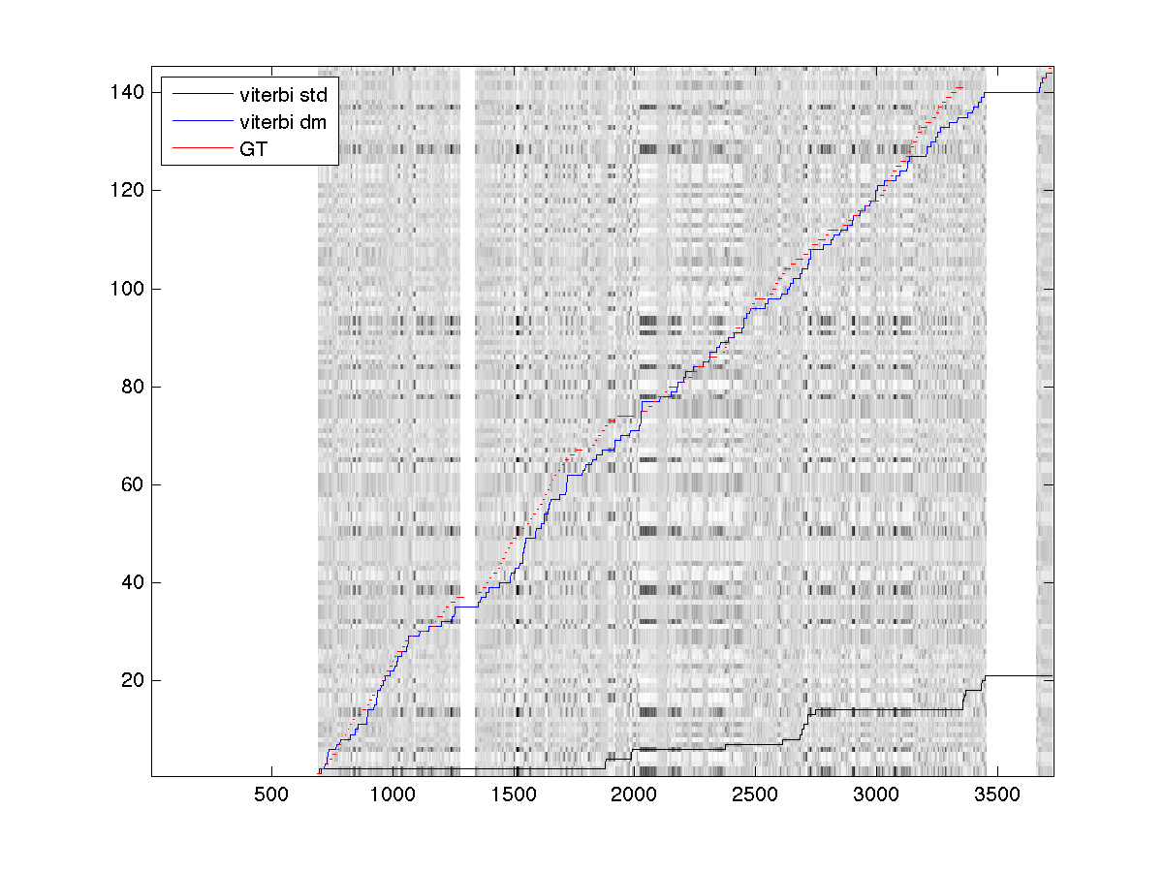
Audio-Lyrics Alignment Examples
티아라 – 숨바꼭질

Slide 32
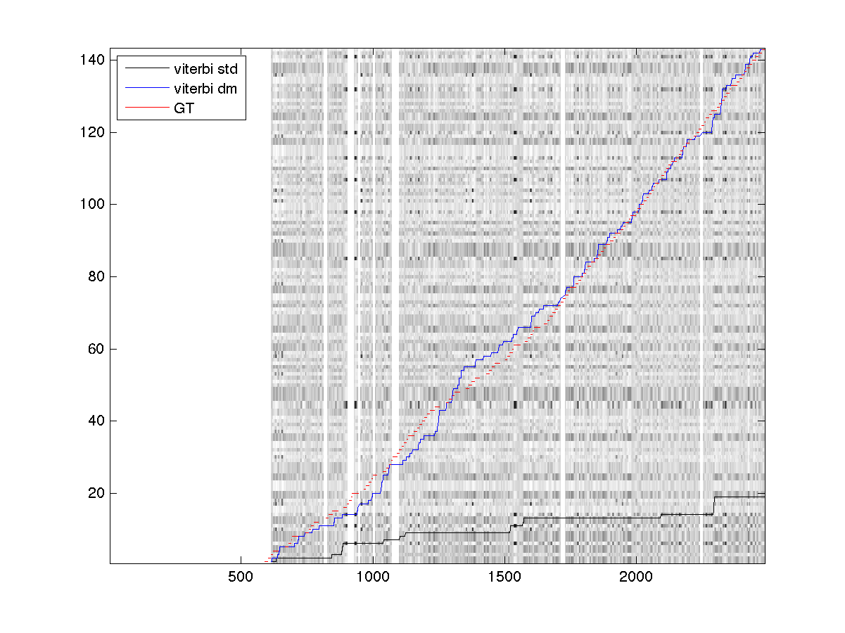
Audio-Lyrics Alignment Examples
G-Dragon - 삐딱하게

Slide 33
Automatic Audio-Lyrics Alignment Demo

